Slide 1
Setup
From nothing to Hello World
Notes:
This is a quick walkthrough to help you get setup with your system

Slide 2
The Server
PHP 5.6 (cli) using the test cli server
pdo_sqlite available
Running on localhost:8080

Slide 3
The Tools
Komodo Edit –
cross platform text editing tool
can use any other text editing tool you're already comfortable with, as long as it has support for PHP
DB Browser for SQLite –
cross platform sqlite database gui
makes learning and working with sqlite easy

Slide 4
The goal
A running PHP webserver
A directory where you can put code, run it through PHP, and view it in your browser
Test with phpinfo and hello world scripts
A tool to edit text files that supports PHP syntax highlighting
A tool to edit sqlite databases

Slide 5

Mac

Slide 6
Installing PHP 5.6
Open terminal and check for PHP 5.6
php –v
Check for pdo_sqlite
php -m

Slide 7
Update your version
http://php-osx.liip.ch/
homebrew
brew options php56
brew install php56

Slide 8
Tools
https://github.com/sqlitebrowser/sqlitebrowser/releases
http://komodoide.com/komodo-edit/
Both have dmg packages for installation on mac
Notes:
komodo edit is prebuilt and ready to go, so is sqlitebrowser in a dmg file ready for install

Slide 9

Windows

Slide 10
The Windows Package
Includes a stripped down PHP executable
Includes a batch file to run the built in server and serve from the code directory inside
You can alter the code location if you choose in the batch file
Includes installers for komodo edit and sqlitebrowser
Notes:
Needs nothing installed – download, unzip, and run

Slide 11
Installing PHP from the Package
Download the package or get from a jump drive – https://github.com/PHPEmbark/packages/releases
Unzip the contents
Double click on the "run.bat" file
It will open a window, do NOT close it, that will shut down your server
Open your browser and go to http://localhost:8080

Slide 12
Installing PHP by Hand
PHP will be wherever you put it
You can still use the run.bat file if you would like to avoid doing command line stuff
You can drag and drop a directory onto the run.bat file to use it as your base directory

Slide 13
Installing PHP
Download PHP –
http://windows.php.net/download
VC11 x86 Non Thread Safe
Unzip to a location of your choice
c:\php works
Grab the code.zip package from https://github.com/PHPEmbark/packages/releases

Slide 14
Configure PHP
open your php directory
rename php.ini-development to php.ini
open your new php.ini file
uncomment extension_dir = "ext"
uncomment extension=php_pdo_sqlite.dll
save the changes

Slide 15
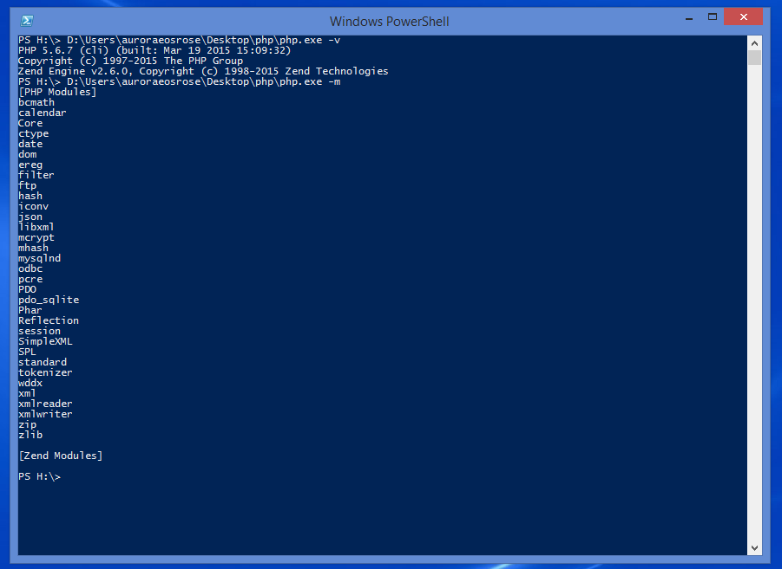
Checking PHP if you know CLI
open a powershell or cmd window and cd to your php location
run php –v
should say PHP 5.6.7 and a bunch more
run php –m
make sure pdo_sqlite is in the list

Slide 16
Running PHP
run
php -S 0.0.0.0:8080 -t ./public/
(where ./public is the directory you want to put your PHP files as you learn)
if a firewall popup appears, allow it
as long as the cmd window is open, your site will be running
visit http://localhost:8080/ in your browser

Slide 17
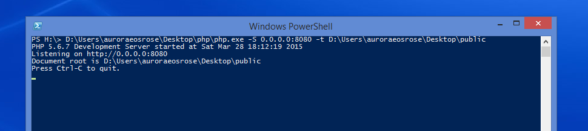
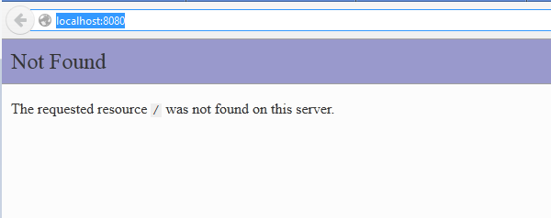

Slide 18
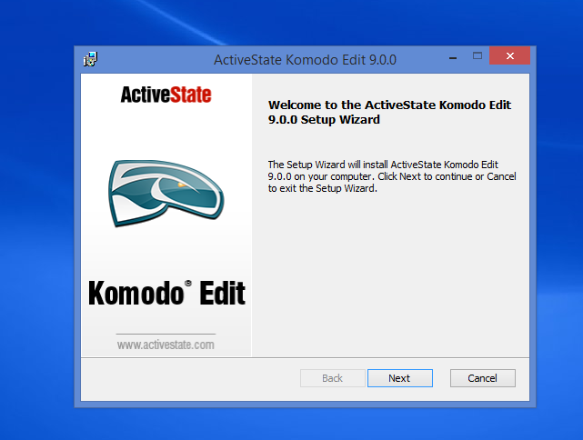
Installing Komodo Edit
Download Komodo Edit – http://komodoide.com/download/#edit
Run the .msi installer

Slide 19
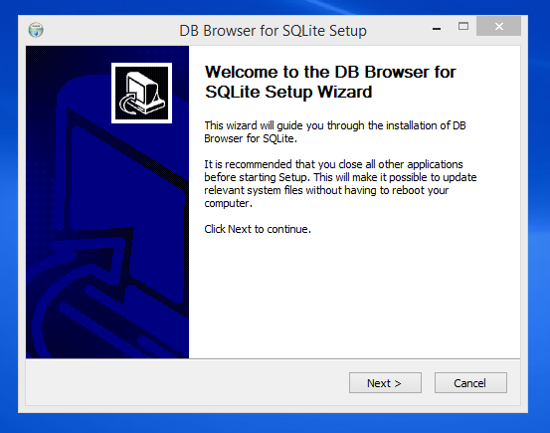
Installing DB Browser
Download DB Browser for Sqlite –
http://sqlitebrowser.org/
choose the windows.exe
run the installer

Slide 20

Linux (Ubuntu)

Slide 21
Installing PHP 5.6
Open terminal and check for PHP 5.6
php –v
Check for pdo_sqlite
php -m

Slide 22
Installing PHP 5.6
sudo apt-get update
sudo apt-get install python-software-properties
sudo add-apt-repository ppa:ondrej/php5-5.6
sudo apt-get update
sudo apt-get dist-upgrade
sudo apt-get install php5 php-sqlite
php –v
php -m

Slide 23
Tools
https://apps.ubuntu.com/cat/applications/sqlitebrowser/
http://komodoide.com/komodo-edit/
These should have installers, be available via apt-get or Ubuntu's software store, or you can compile them
Notes:
There should be builds available for both these tools, you can build sqlitebrowser from a recent git checkout as well

Slide 24
Hello World
Making sure we can run PHP code

Slide 25
Testing PHP Configuration
Create a file called info.php in your document root ( or download code.zip from https://github.com/PHPEmbark/packages/releases)
Use the opening tag (<?php) to turn on PHP parsing
Write phpinfo(); on the second line
Close with ?>
Save the file and visit http://localhost:8080/info.php
Notes:
(this is already present in the windows package, on linux or mac it's the path you used when you started the webserver)

Slide 26
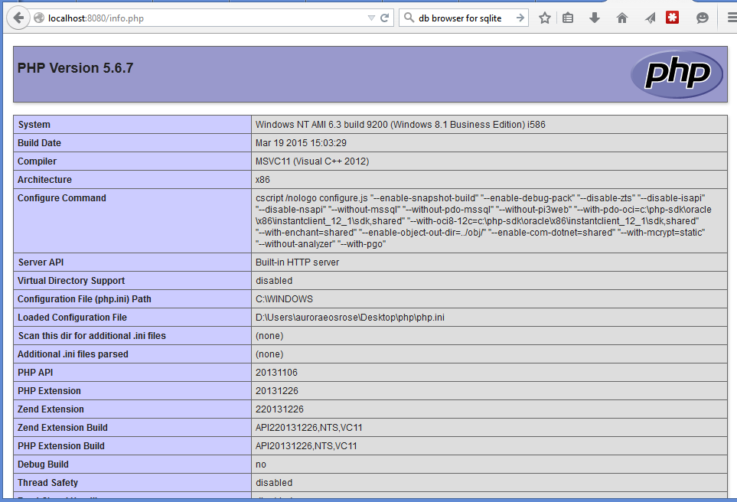
<?php
phpinfo();
?>
Notes:
The first item shows assignment
This is doing something with the variable
This will cause a PHP Notice to be shown
by default it is given a null value
Output:
1
Notice: Undefined variable: missing in {filename} on line 7

Slide 27
Testing PHP Code
Create a file called hello.php in your document root
Use the opening tag (<?php) to turn on PHP parsing
Write echo "Hello World"; on the second line
Close with ?>
Save the file and visit http://localhost:8080/hello.php

Slide 28
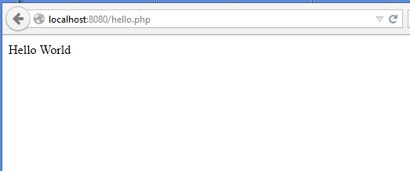
<?php
echo "Hello World";
?>
Notes:
This is a very very simple test to make sure php is working
php tags
echo means “show this to me”
don’t necessarily need closing tags

